Slide 1


DBA
Database Security and Authorization

Slide 2
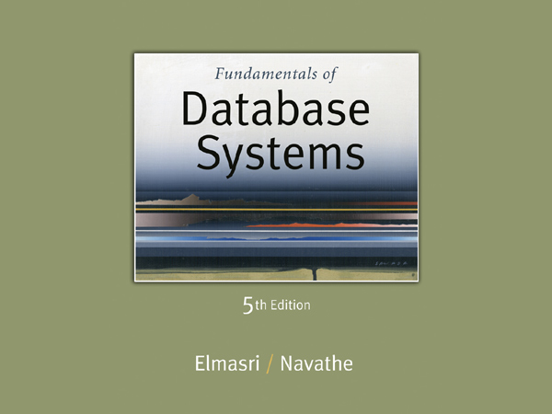

Slide 3

Chapter Outline
Database Security and Authorization
Types of Security
Database Security and DBA
Access Protection, User Accounts
Discretionary Access Control(DAC)
Grant/Revoke Privileges, GRANT OPTION
Mandatory Access Control (MAC)
Role Based Access RBAC
Encryption
Password Protection

Slide 4
Introduction to Database Security
The security mechanism of a DBMS must include provisions for restricting access to the database as a whole
This function is called access control and is handled by
creating user accounts and passwords to control login process by the DBMS.

Slide 5
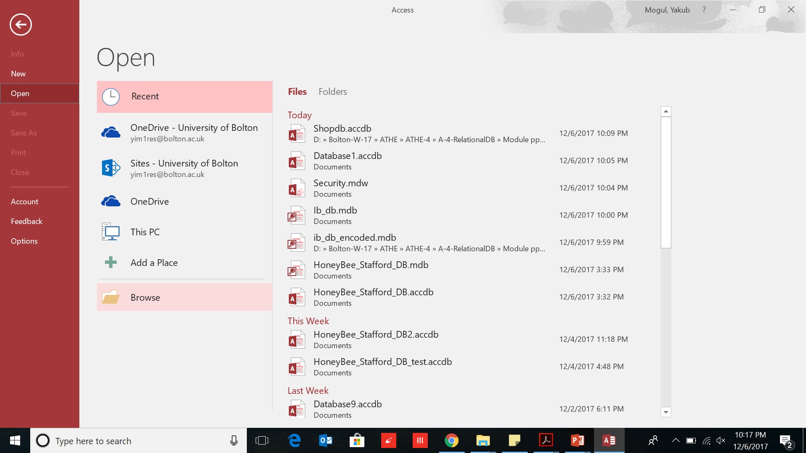
Encrypt database with a password
Goto File Tab->Open->Browse icon

Slide 6
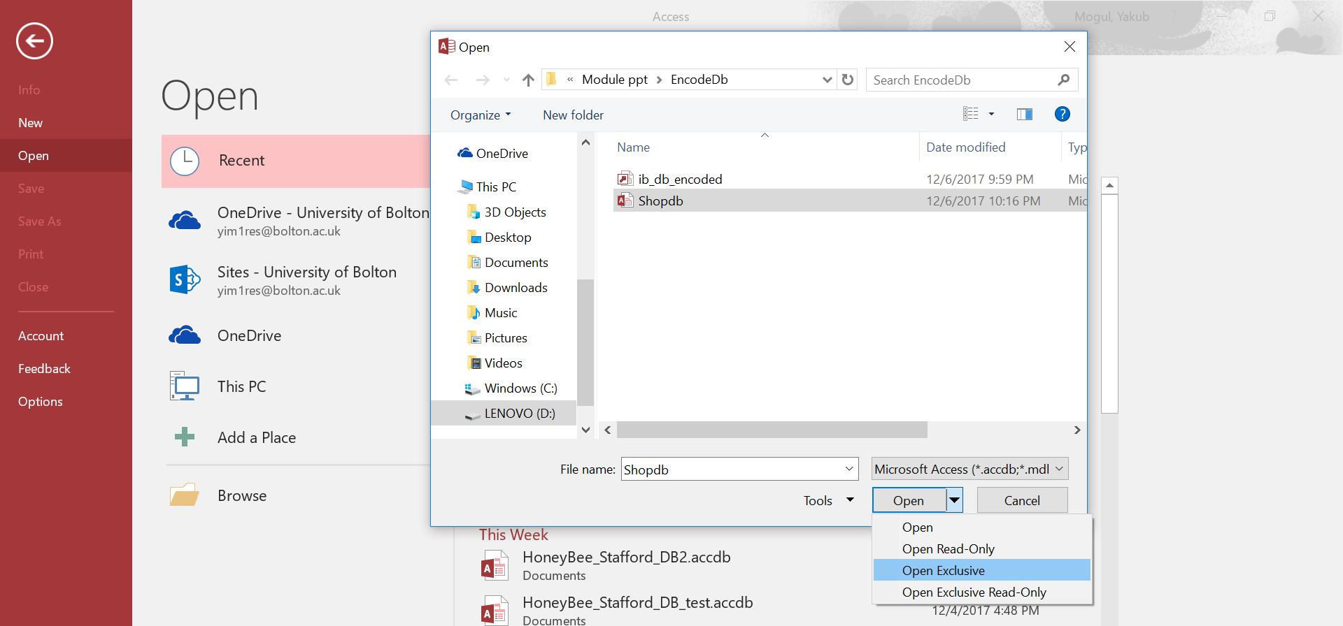
Encrypt database with a password
Select your database.
Click dropdown of Open.
Select Open Exclusive option

Slide 7

Database is opened in Exclusive Mode
Encrypt database with a password

Slide 8
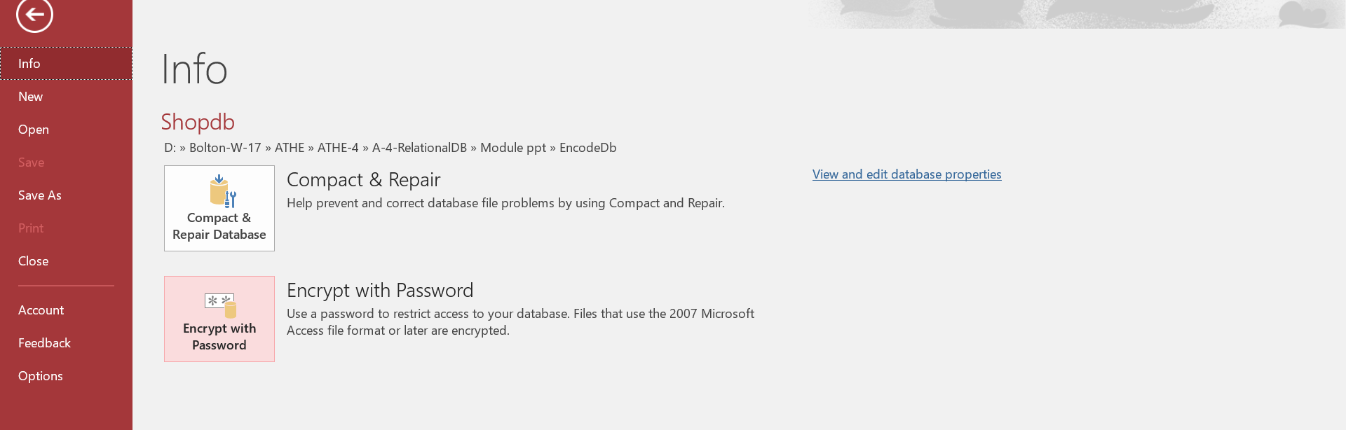
Goto File. Click on Encrypt with Password
Encrypt database with a password

Slide 9
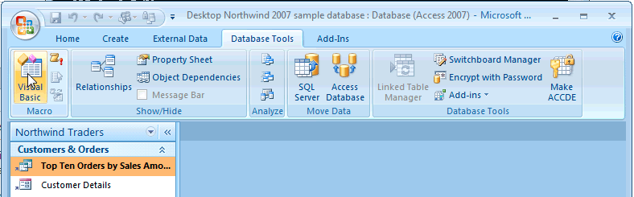
Goto Database Tools tab on top . Click on Encrypt with Password
Encrypt database with a password
OLD MSACCESS THEN DO THIS ELSE SKIP

Slide 10
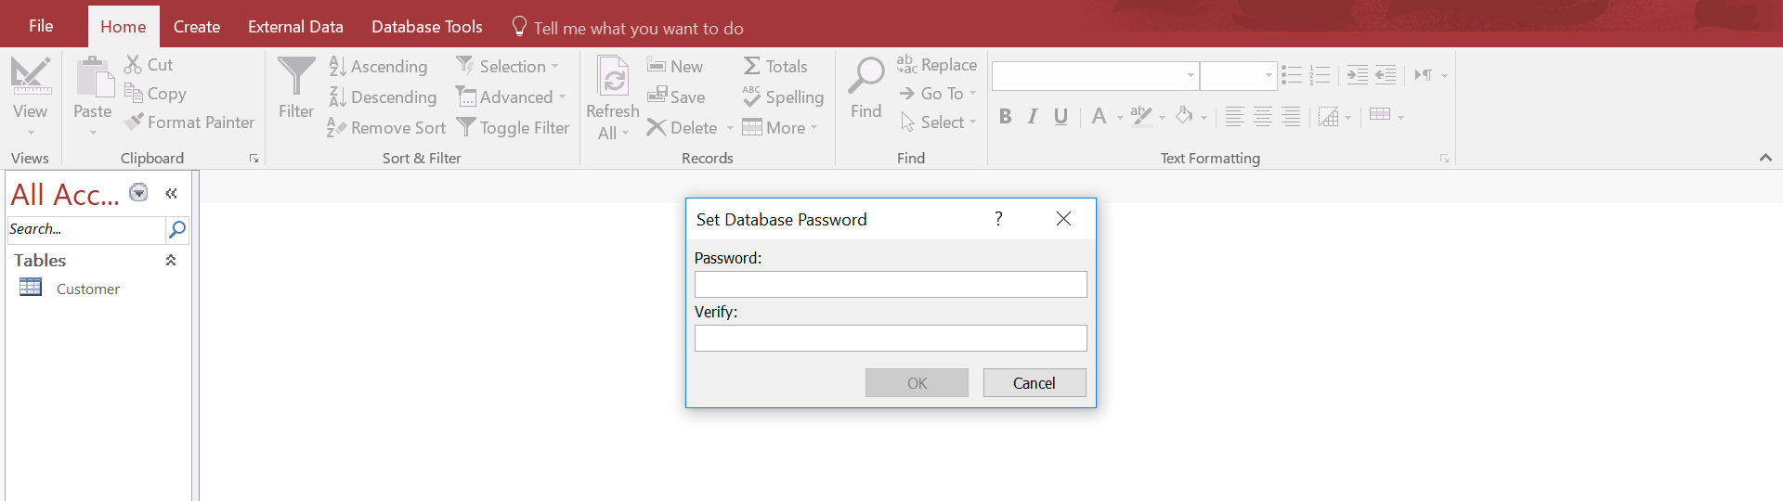
Encrypt database with a password

Slide 11
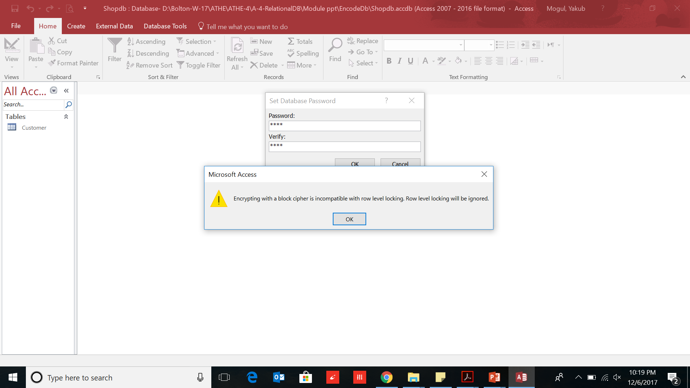
Enter password:1234
Encrypt database with a password

Slide 12
Encrypt database with a password
Save db and close.
Open again.
It asks for password

Slide 13
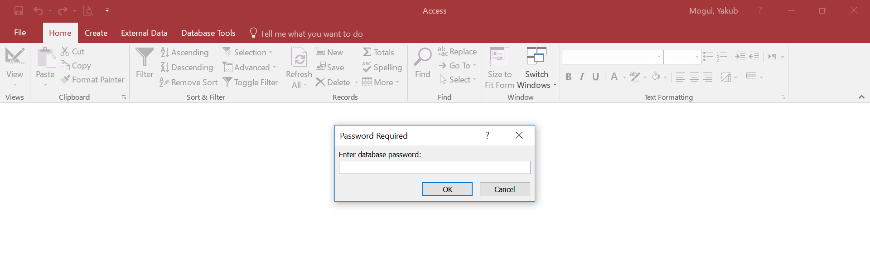
Decrypt database with password

Slide 14
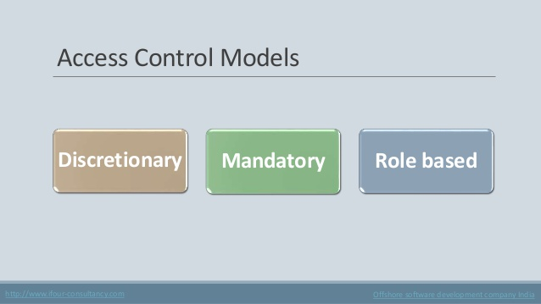
Database Security
A DBMS includes a database security and authorization subsystem
responsible for ensuring the security of a database against unauthorized access.
Types of database security mechanisms:
Discretionary Access Control(DAC)
(Optional/Flexible)
Mandatory Access Control(MAC)
(Needed)
Role Based Access Control

Slide 15
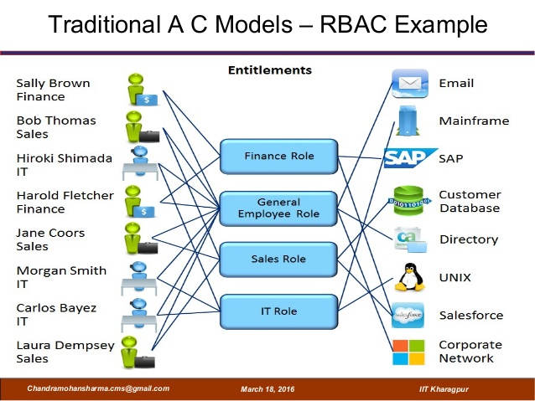
Database Security and the DBA
The database administrator (DBA) is the central authority for managing a database system.
The DBA’s responsibilities include
granting privileges to users who need to use the system
classifying users and data based on policy of the organization
The DBA is responsible for the overall security of the database system.

Slide 16
Database Security and the DBA (contd..)
The DBA has a DBA account in the DBMS
These accounts provide powerful capabilities such as:
1. Account creation
2. Privilege granting
3. Privilege revocation
4. Security level assignment
1 is access control,
whereas 2 and 3 are discretionary and
4 is used to control mandatory authorization

Slide 17
Access Protection, User Accounts
Whenever a person or group of persons need to access a db system,
the individual or group must first apply for a user account.
The DBA will then create a new account id and password for the user
The user must log in to the DBMS by entering account id and password whenever database access is needed.

Slide 18


Discretionary Access Control
Discretionary access control in a database system is based on the
granting privileges/permissions and
revoking them

Slide 19


Database Security
Management of users
Grant and Revoke: Definition
Grant:
The GRANT statement is used to give permissions to a user or role
Assign permissions on both :
statements
(Insert, Update, Select, Delete)
as well as
objects
(Tables, Views, Forms)
You can use the GRANT statement with the
WITH GRANT OPTION clause
to permit the user or role receiving the permission to further grant/revoke access to other accounts

Slide 20

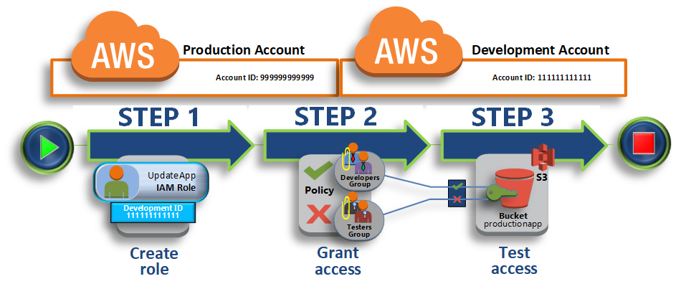
Insert
Select
Update
Delete

Slide 21

Database Security
Management of users
Grant and Revoke: Definition
Revoke:
The REVOKE statement is used to
remove a previously granted permission
from a user in the current database.

Slide 22
Database Security
Management of users
Syntax & Sémantic
Grant and Revoke
MySQL
GRANT priv_type [(column_list)] [, priv_type [(column_list)] ...]
ON {tbl_name | * | *.* | db_name.*}
TO user_name [IDENTIFIED BY 'password']
[, user_name [IDENTIFIED BY 'password'] ...]
[WITH GRANT OPTION]
REVOKE priv_type [(column_list)] [, priv_type [(column_list)] ...]
ON {tbl_name | * | *.* | db_name.*}
FROM user_name [, user_name ...]

Slide 23
Database Security
Management of users
Oracle Syntax
Grant and Revoke
GRANT
SELECT, INSERT, UPDATE, DELETE ON tablename
TO username;
REVOKE
SELECT
ON tablename
FROM username;

Slide 24
Database Security
Management of users
Grant Example:
Grant and Revoke
if you wanted to grant
select, insert, update, and delete privileges on a table called suppliers
to a user name smithj,
you would execute the following statement:
GRANT
SELECT, INSERT, UPDATE, DELETE
ON SUPPLIERS
TO SMITHJ;
You can also use the all keyword to indicate that you wish all permissions to be granted. For example:
GRANT ALL ON SUPPLIERS TO SMITHJ;

Slide 25
Database Security
Management of users
Revoke Example
Grant and Revoke
Once having granted privileges, you may need to revoke/remove some or all of these privileges.
To do this, you can execute a revoke command.
Eg: if you want to revoke delete privileges on a table called suppliers from a user named anderson, you would execute the following statement:
REVOKE DELETE ON SUPPLIERS
FROM ANDERSON;
revoke all privileges on a table, use the all keyword. E.g:
REVOKE ALL ON SUPPLIERS FROM ANDERSON;

Slide 26
Propagation of Privileges using the GRANT OPTION
Whenever the owner A of a relation R grants a privilege on R to another account B, privilege can be given to B with or without the GRANT OPTION.
If the GRANT OPTION is given, this means that B can also grant that privilege on R to other accounts.
Suppose that B is given the GRANT OPTION by A and that B then grants the privilege on R to a third account C, also with GRANT OPTION.
In this way, privileges on R can propagate to other accounts without the knowledge of the owner of R.
If the owner account A now revokes the privilege granted to B, all the privileges that B propagated based on that privilege should automatically be revoked by the system.

Slide 27
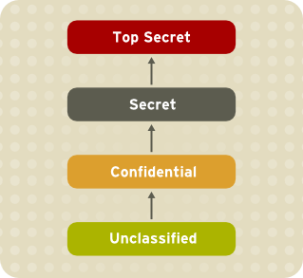
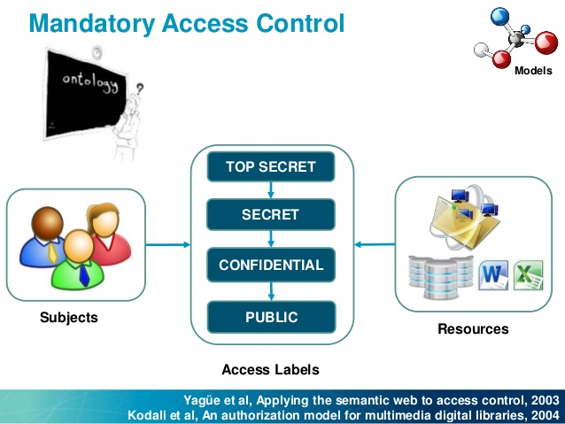
Mandatory Access Control(MAC)
Security policy classifies data and users based on security classes.

Slide 28
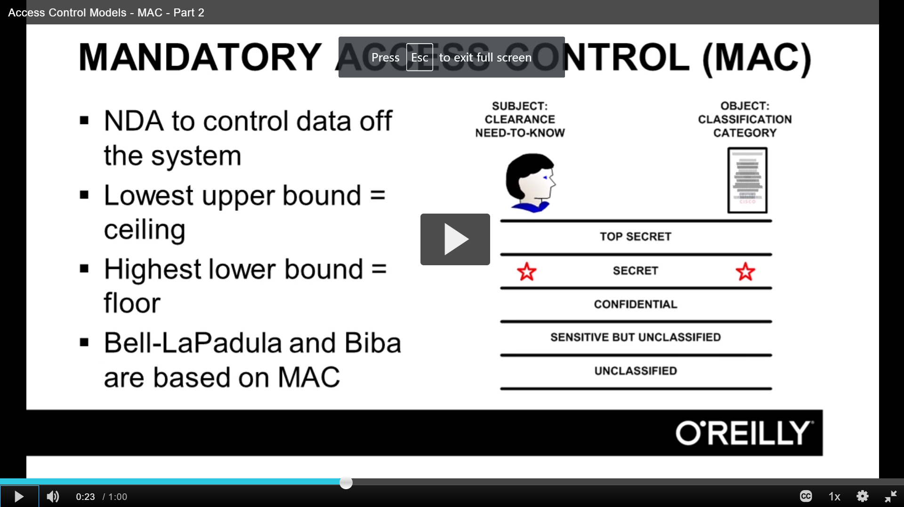
Mandatory Access Control(MAC)
Security policy classifies data and users based on security classes.
https://www.oreilly.com/library/view/cissp-certification-training/9781771376044/video241971.html

Slide 29
Mandatory Access Control (2)
Typical security classes are
top secret (TS),
secret (S),
confidential (C), and
unclassified (U),
TS is the highest level and U the lowest: TS ≥ S ≥ C ≥ U
Bell-LaPadula model, classifies
each subject (user, account, program) and
object (table, row, column)
into one of the security classifications, T, S, C, or U:
Clearance (classification) of a subject S as class(S) and to the classification of an object O as class(O).

Slide 30
MAC( contd..)
Main relation has the form:
Name | C_name | Dept | C_dept | Prof | C_prof | TC
J Smith | S | Dept1 | S | Cryptography | TS | TS
M Doe | U | Dept2 | S | IT Security | S | S
R Jones | U | Dept3 | U | Secretary | U | U
U = unclassified : S = Secret : TS = Top Secret

Slide 31
MAC( contd..)
Main relation has the form:
Name | C_name | Dept | C_dept | Prof | C_prof | TC
J Smith | S | Dept1 | S | Cryptography | TS | TS
M Doe | U | Dept2 | S | IT Security | S | S
R Jones | U | Dept3 | U | Secretary | U | U
A user with class(user)=S gets below view of the data
NAME | Dept | Prof
J Smith | Dept1 | ---
M Doe | Dept2 | IT Security
R Jones | Dept3 | Secretary

Slide 32
MAC( contd..)
Main relation has the form:
Name | C_name | Dept | C_dept | Prof | C_prof | TC
J Smith | S | Dept1 | S | Cryptography | TS | TS
M Doe | U | Dept2 | S | IT Security | S | S
R Jones | U | Dept3 | U | Secretary | U | U
A user with class(user)=U gets below view of the data
NAME | Dept | Prof
M Doe | --- | ---
R Jones | Dept3 | Secretary

Slide 33
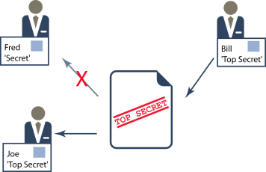
Mandatory Access Control (3)
Restrictions are enforced on data access based on the subject/object classifications:
Simple security property:
A subject S is not allowed read access to an object O unless class(S) ≥ class(O).
https://www.isode.com/whitepapers/security-labels-clearance.html

Slide 34
Comparing Discretionary Access Control and Mandatory Access Control
Discretionary Access Control (DAC)
highly flexibile,
suitable for a large variety of application domains.
Drawback
vulnerability to malicious attacks, such as Trojan horses embedded in application programs.

Slide 35
Comparing Discretionary Access Control and Mandatory Access Control(2)
Mandatory policies(MAC)
ensure a high degree of protection
Drawback -too rigid and applicable in limited environments.
In many practical situations, discretionary policies are preferred because they offer a better trade-off between security and applicability.

Slide 36
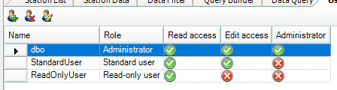
Role-Based Access Control
Role-based access control (RBAC) enforce security in large-scale enterprise-wide systems.
Its basic notion is that permissions are associated with roles, and users are assigned to appropriate roles.
Roles can be created using the CREATE ROLE and DESTROY ROLE commands.
The GRANT and REVOKE commands discussed under DAC can then be used to assign and revoke privileges from roles.

Slide 37
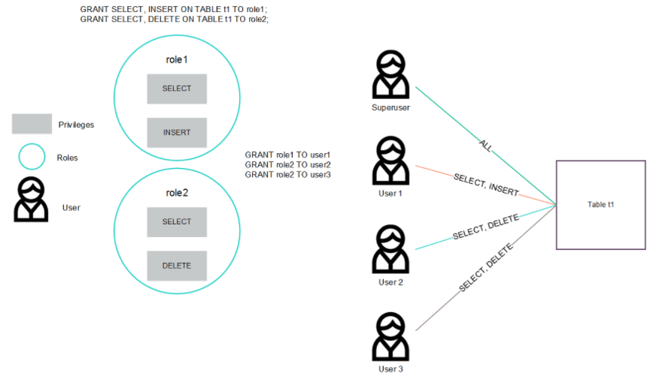
RBAC
Shah S. (2017) Understanding Users, Privileges, and Roles
Available from: https://www.vertica.com/blog/understanding-users-privileges-roles/. [Accessed 8 January 2010].
(Shah, 2017)

Slide 38
Role-Based Access Control(2)
RBAC appears to be a viable alternative to traditional discretionary and mandatory access controls;
it ensures that only authorized users are given access to certain data or resources.
Many DBMSs have allowed the concept of roles, where privileges can be assigned to roles.
Role hierarchy in RBAC is a natural way of organizing roles to reflect the organization’s lines of authority and responsibility.

Slide 39
Encryption
Encryption is a means of maintaining secure data in an insecure environment.
Encryption consists of applying an encryption algorithm to data using some prespecified encryption key.
The resulting data has to be decrypted using a decryption key to recover the original data.

Slide 40
Summary
1 Database Security and Authorization
2 Discretionary Access Control
3 Mandatory Access Control and
4 Role-Based Access Control for Multilevel Security
5 Encryption and Public Key Infrastructures

